Slide 1
Ethnotech: Solidworks
Name: M SRIHARI
Reg. No.: 25UMT052
Department: Mechatronics

Slide 2
Types of Manufacturing in Solidworks
List of Mandatory Departments in a company (ordered)
There are 4 types of manufacturing that are done while using Solidworks software that was discussed in the training.
1. Sutractive Manufacturing
2. Fabrication
3. Molding
4. Additive Manufacturing
Design
Sales
Manufacturing
Project
Quality
Maintainence
Purchase
Dispatch
Sales and Marketing:
– A crucial role in driving business growth and ensuring that products reach the right customers.
Design/R&D:
Developing new products and improving existing designs.
Production/Manufacturing:
Overseeing the creation of mechanical components and systems.
Purchase & Procurement:
Handling materials and equipement sourcing.
Quality Control:
Ensuring products meet industry standards and specifications.
Project Management:
Leading engineering projects from conception to completion.
Maintenance:
Keeping machinery and equipment in optimal working condition.
Production Planning Control:
Managing workflow safety and efficiency in manufacturing.
Safety/Security:
Ensuring workplace safety and compliance.
PLM/SAP:
Managing product lifecycle and enterprise resource planning.

Slide 3
Why we need Design:
1) Problem Solving:
Design helps us identity problems and create solutions. Transforms ideas into practical, usable products or systems.
2) Communication:
Visual design (CAD models, drawings) communicate intent clearly across teams: engineers, manufacturers, clients.
3) Efficiency & optimization:
4) Innovation:
Drives creativity and innovation by exploring new forms, materials and technologies. Leads to better, smarter, more competitive products.
5) User experience:
Ensures the product is safe, easy to use, and aesthetically pleasing. Directly impacts customer satisfaction and success in the market.
6) Compliance & standards.
Design ensures the product is safe, easy to use and aesthetically pleasing.
How the design is to be?
Deriving standardizations in design. 2) Bench marking of best in design 3) Design to incorporate cost effective manufacturing. 4) Continual improvement of design. 5) On time delivery of design. 6) First time right approach and rework reduction by continual improvement. 7) To deliver best system aesthetic. 8) Creating and control of design and design related documentation

Slide 4
Rules and Responsibilities of a Designer
To take and analyse the customer requirement.
To prepare concept, cycle time chart and costings for preparing quotation.
After finalising to prepare the concept in 3D and disucss related points.
Preparing design approval process (DAP)
To prepare simulation video
To segregate ought out items and manufacturing items.
To prepare purchase request for bought out items.
To prepare detailing in 2D.
To make correction in 2D with assembly drawing and fastners list and release drawing.
To check quotation.
To conduct CMM inspection support and take trial.
To prepare manual drawing.
Additional Responsibility
To arrange for fixture assembly
Supplier followup and check the quotation
To check/inspect the specification of drawing while manufacturing at supplier end.
After receiving the materials from supplier end, to conduct final inspection.
After preparing PR, check with stores in respect to PR raised.
After receiving materials to check if the materials received match with PR raised
Provide support while despatch.

Slide 5
First Angle Projection:
Object will be always on first angle projection.
Observer is always on right or top side.
Object seen from right side will be projected in left side.
Object seen from top side will be projected in bottom side.
Considering the planes which are projected is opaque.
Conditions:
  The object is placed between the viewer and the observer.
  Assume: VP and HP are not transparent.
Summary of steel types
  EN8(080M40): A medium carbon steel offering a balance of strength and toughness, suitable for shafts, gear and bolts.
  EN24(817M40): An alloy steel with higher tensile strength and toughness heavy duty shafts and gears.
  MS(Mild Steel): Low carbon content steel, easy to weld and form, commonly used in general structural applications.
  HCHCR(High Carbon High Chromium Steel)
  C4SCAIS

Slide 6
For the final project at the end of the training, we tried to replicate 4 Chamber Engine Assembly model.

Slide 7
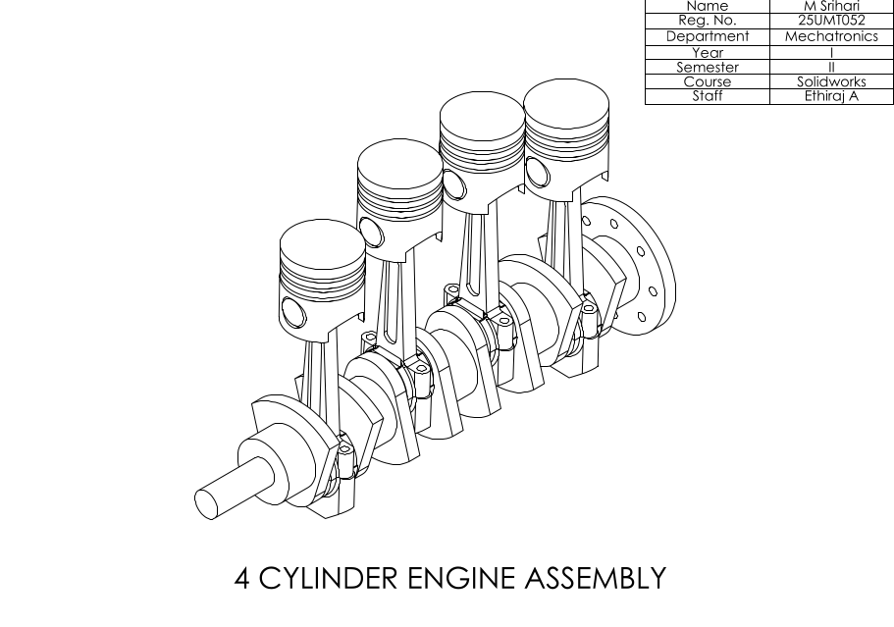

Slide 8
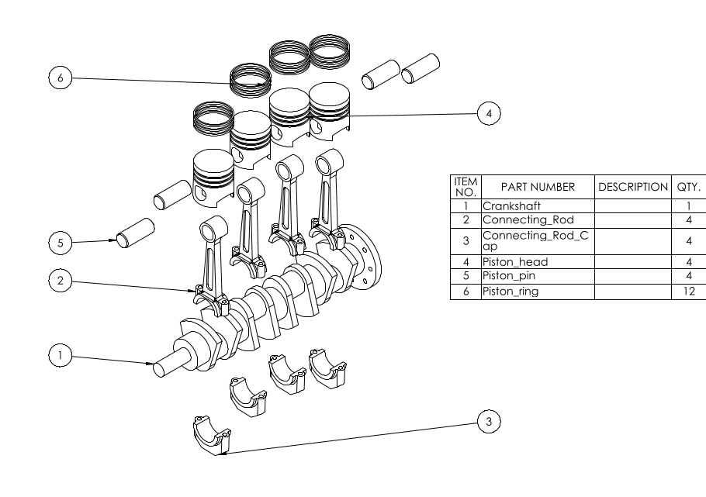

Slide 9
